Slide 1

OOH (Out Of Home) Advertisement
May 06, 2021

Slide 2
2018~2020 Japan Advertising Expenses
媒体＼広告費 AD Spend by Channel |  | 広告費（億円）AD Spend (100 million yen) |  |  | 前年比（％）Year-over-Year |  | 構成比（％）Contribution
 |  | 2018年 | 2019年 | 2020年 | 2019年 | 2020年 | 2018年 | 2019年 | 2020年
総広告費 (Total AD Expense) |  | 65,300 | 69,381 | 61,594 | 106.2 | 88.8 | 100 | 100 | 100
マスコミ四媒体広告費 (The 4 Main Mass Media Expense) |  | 27,026 | 26,094 | 22,536 | 96.6 | 86.4 | 41.4 | 37.6 | 36.6
インターネット広告費 (Internet AD expense) |  | 17,589 | 21,048 | 22,290 | 119.7 | 105.9 | 26.9 | 30.3 | 36.2
プロモーションメディア広告費 (Promotional Media Ad Expense) |  | 20,685 | 22,239 | 16,768 | 107.5 | 75.4 | 31.7 | 32.1 | 27.2
 | 屋外 (Outdoor) | 3,199 | 3,219 | 2,715 | 100.6 | 84.3 | 4.9 | 4.6 | 4.6
 | 交通 (Public Transport) | 2,025 | 2,062 | 1,568 | 101.8 | 76 | 3.1 | 3 | 2.6
 | 折込 （Flyers and Leaflets) | 3,911 | 3,559 | 2,525 | 91 | 70.9 | 6 | 5.1 | 4.1
 | DM（ダイレクト・メール）(Direct Mail) | 3,678 | 3,642 | 3,290 | 99 | 90.3 | 5.6 | 5.3 | 5.3
 | フリーペーパー (Free Paper) | 2,287 | 2,110 | 1,539 | 92.3 | 72.9 | 3.5 | 3.1 | 2.5
 | POP (Point of Purchase Ads) | 2,000 | 1,970 | 1,658 | 98.5 | 84.2 | 3.1 | 2.8 | 2.7
 | イベント・展示・映像ほか (Event・Exhibit) | 3,585 | 5,677 | 3,473 | 158.4 | 61.2 | 5.5 | 8.2 | 5.6
“Internet ad expense” grew to 2,229 billion yen (105.9% year-on-year) from pandemic induced digital transformation, from increased demand of online delivery, shopping, meeting events, remote work, and cashless payments etc.
“Promotional media advertising expenses” also fell sharply to 1,676.8 billion yen (75.4% year-on-year) because of postponement / cancellation of various events and campaigns, as well as refraining from going out / moving.
https://www.dentsu.co.jp/knowledge/ad_cost/2020/media.html
Notes:
3,199 is 3.1 trillion yen.

Slide 3
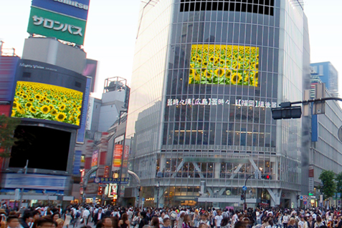
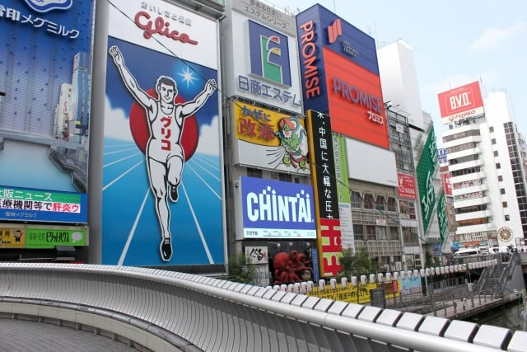
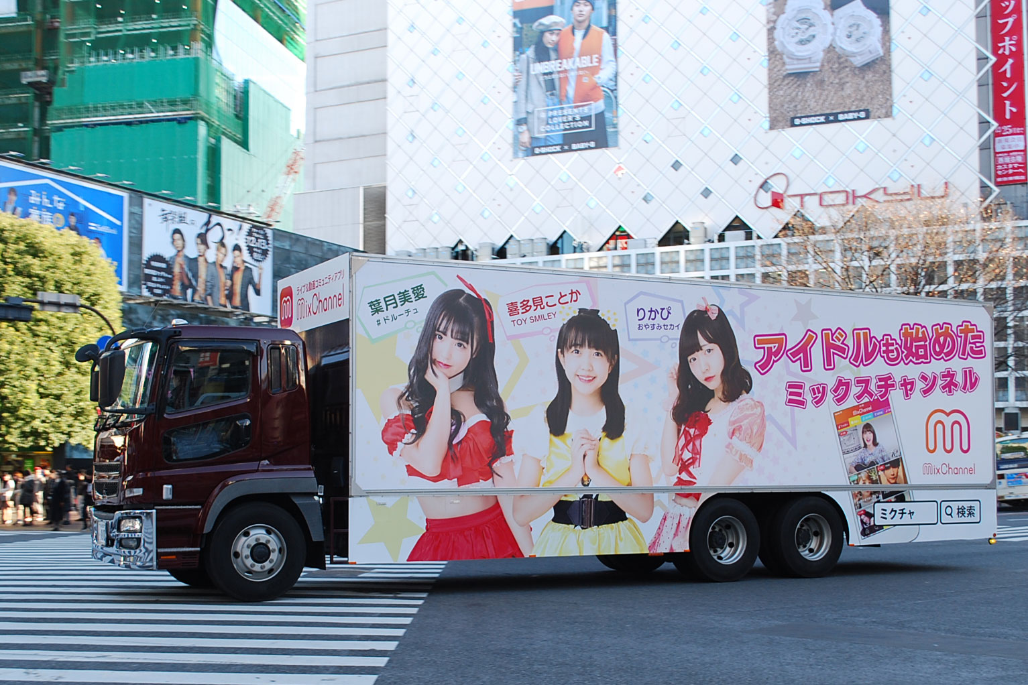
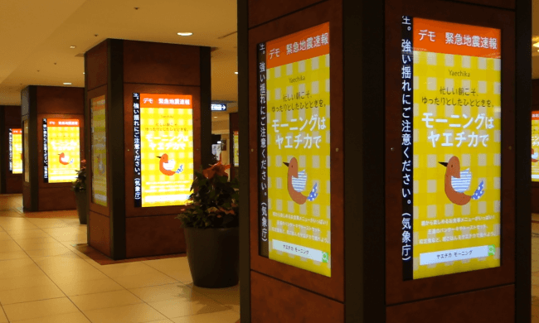
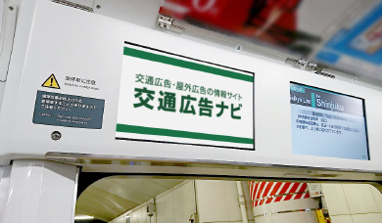
Types of OOH
Outdoor Vision | 屋外ビジョン
Signboards (Kanban)| 看板広告
Ad Trucks | アドトラック
Video clips broadcasted along with audio from screens installed on buildings.
Notable locations include, Shibuya Scramble Square and Shinjuku Alta.
Printed posters installed on buildings, and sometimes on utility poles and signboards on sidewalks.
Printed advertising displays wrapped around the trucks that are than driven around a certain area.
Digital Signage | デジタルサイネージ
Public Transports | 交通広告
Advertising displays placed on the interior and exterior of trains and inside train stations and platforms. Can be used for other forms of public transit such as Taxi’s and Buses.
Digital displays using technologies such as LCD, LED, projection and e-paper to display digital images, video, web pages, weather data, restaurant menus, or text.
Used in locations such as, inside stations, hospitals, restaurants and government offices.

Slide 4
Distributors of OOH Campaigns
Transit and outdoor media placements belong to the owners of the building or companies that buy the rights to operate and distribute the OOH campaigns.
US | JP | Homepage
JR East | ジェイアール東日本企画 | https://www.jeki.co.jp/transit/index.html
Tokyu | 東急エージェンシー | http://www.tokyu-ooh.jp/
Odakyu Transit | 京王エージェンシー | https://www.odakyu-ag.co.jp/transit-media/
Keio Media | 京王エージェンシー | https://ooh-media.keio-ag.co.jp
Keikyu AD Enterprise | 京急交通広告メディア | https://www.keikyu-ad.co.jp/media
Liveboard（NTT Docomo x Dentsu) | ライブボード | https://liveboard.co.jp/en/vision/
JR West Media Guide | JR西日本交通広告 | https://www.jcomm.co.jp/transit/price/media_guide/2021/pdf/mg_all.pdf
Narita Airport Media Guide | 成田空港メディアガイド | https://www.gpa-net.co.jp/ja/ads-promotion/
OriCom | オリコム | https://www.oricom.co.jp/special/ryokin/

Slide 5
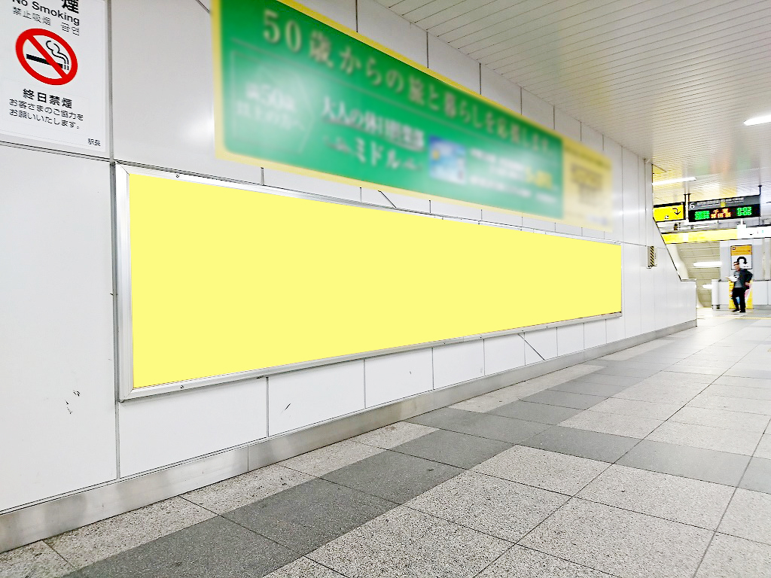
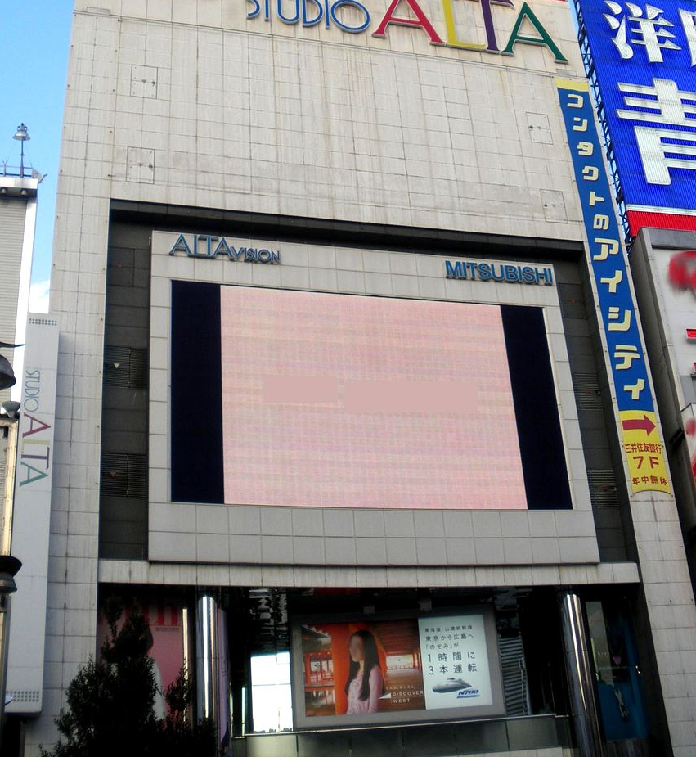
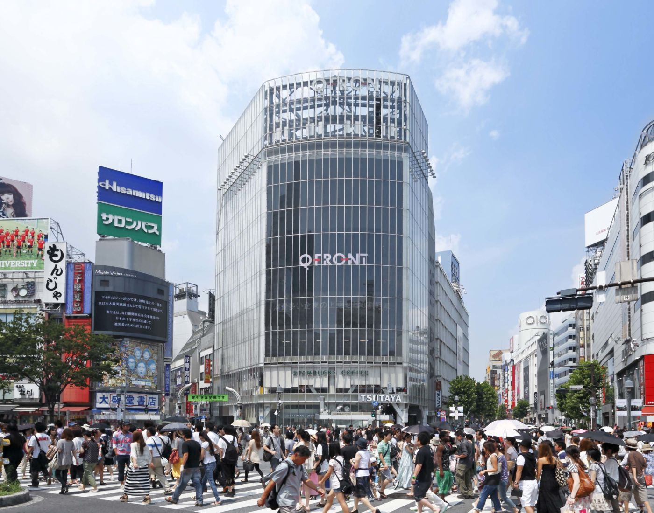
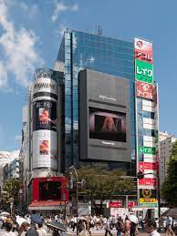
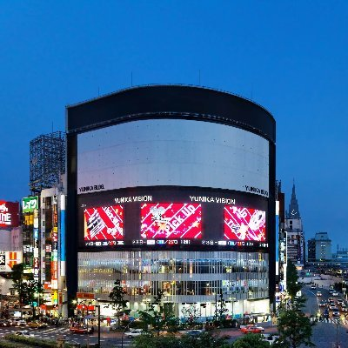
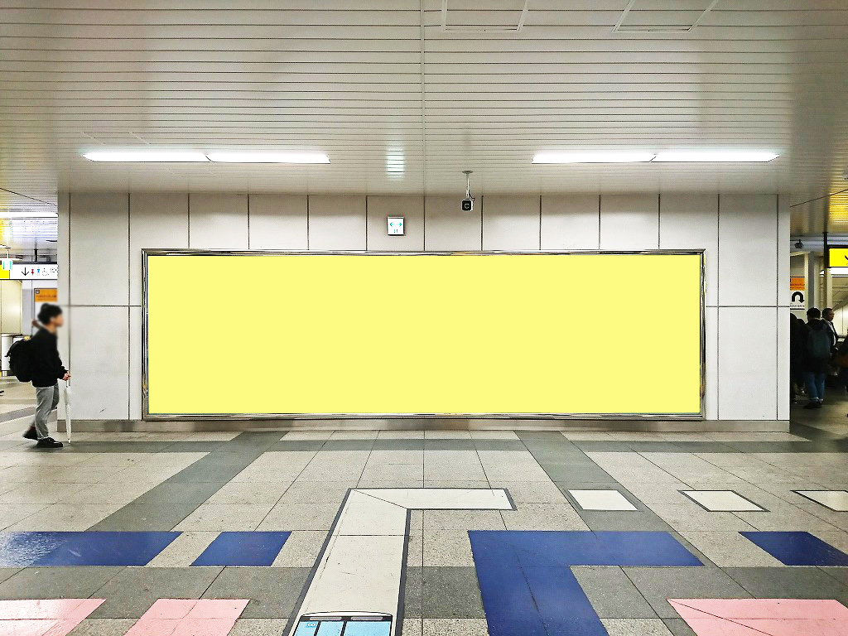
Pricing of OOH Campaigns
Price of the OOH campaigns depends on many different conditions. There is no one-size-fits all pricing:
Location 2) Duration of placement 3) Size of the ad 4) Type of OOH etc.
Long Size Billboard
City | Price | Days
Tokyo | ￥300,000 | 7
Shinbashi | ￥300,000 | 7
Akihabara | ￥300,000 | 7
Ikebukuro | ￥300,000 | 7
Omiya | ￥300,000 | 7
Yoyogi | ￥200,000 | 7
Yokohama | ￥300,000 | 7
Outdoor Vision
Name | City | Price | Days | Frequency
Studio Alta | Shinjuku | ￥600,000 | 7 | 15 sec X broadcast 28 times
YUNIKA VISION | Shibuya | ￥500,000 | 7 | 15 sec X broadcast 36 times
Q’s Eye | Shibuya | ￥500,000 | 7 | 15 sec X broadcast 30 times
109 Forum Vision | Shibuya | ￥399,000 | 7 | 15 sec X broadcast 30 times
Panorama Size Billboard
City | Price | Days
Akihabara | ￥800,000 | 7
Ikebukuro | ￥800,000 | 7
Shibuya | ￥800,000 | 7
Tokyo | ￥1,300,000 | 7
Shinbashi | ￥1,300,000 | 7
https://www.gentosha-mc.com/column/dertail265/
https://www.koutsu-navi.com/search/station/poster/poster_jr.html#poster01

Slide 6
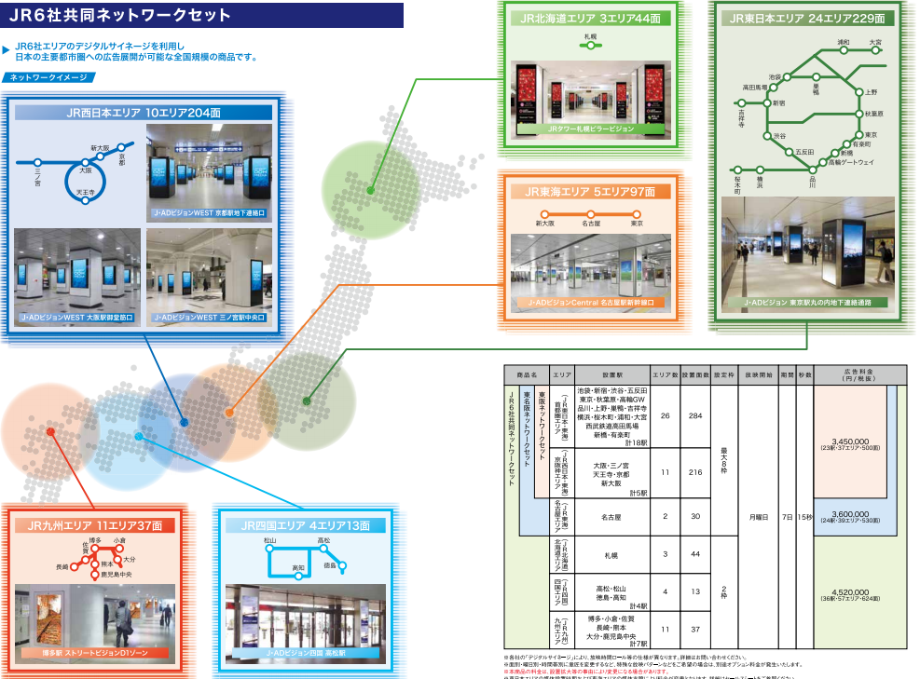
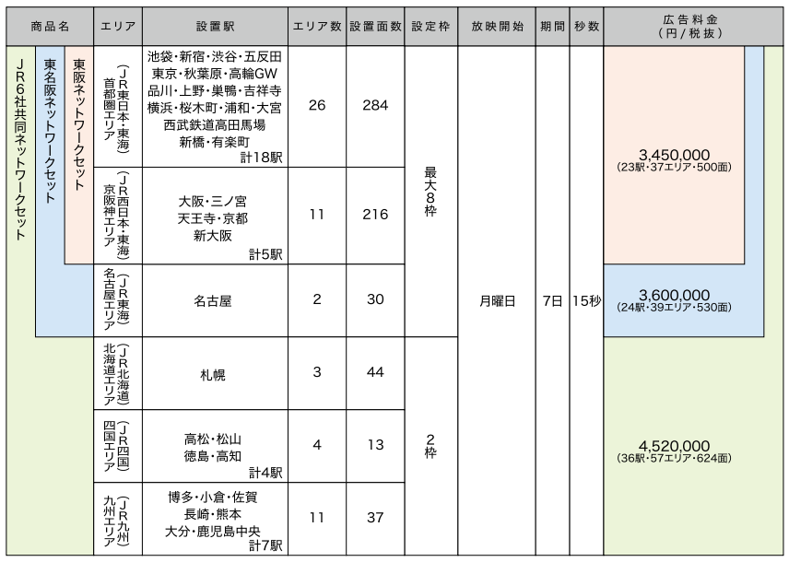
Packages of OOH Campaigns
OOH campaign placements can be purchased in packages at a set price instead of by individual placements.
This is a sample package of the JR joint network plan covering stations and areas across 6 JR companies.
JR Network / Area
Stations
Area Count
Days / Time
Price
https://www.jcomm.co.jp/transit/price/media_guide/2021/pdf/mg_all.pdf

Slide 7
Innovations of DOOH
Optimization: While the majority of OOH inventory is printed, more digital screens are becoming available for advertisers to create more dynamic campaigns. These screens are producing better optimization and allowing advertisers to create more personalized messaging.
Enabling Digital Buying: The purchasing of OOH advertising was previously a lengthy process between the advertiser, digital marketing agency and inventory owner. With this model, the real-time strategies that now dominate the DOOH world would not be possible. Programmatic buying of OOH media is now commonplace.
Attribution and measurement: OOH campaigns were traditionally difficult to measure the performance. Through digitized OOH, marketers can acquire detailed metrics around their digital campaigns down to impressions and conversions.
LIVE BOARD Inc, a joint venture between NTT DOCOMO, INC. and Dentsu Inc., is Japan’s first impression-based DOOH ad network operator. https://liveboard.co.jp/en/solutions/

Slide 8
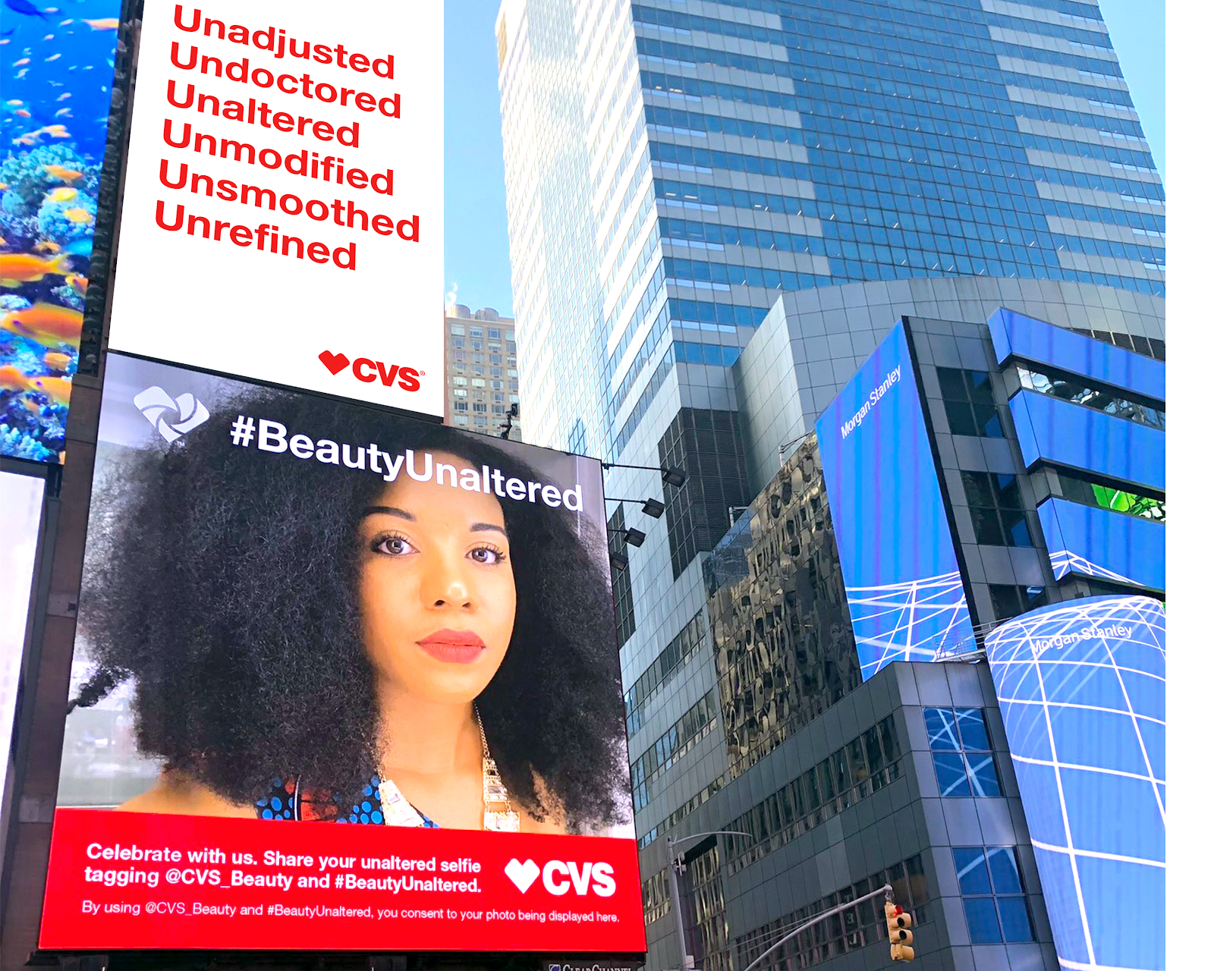
Innovations of DOOH: Social Media
Locations: New York City’s Times Square
Company: CVS
Campaign: Beauty Mark Social Media Campaign
Innovations: This campaign incorporated interactive capabilities using Social Media. This interactive campaign encouraged users to upload their unedited selfies to social media with the hashtag #BeautyUnaltered. Within minutes of launching the campaign, users began uploading unaltered, unfiltered selfies using #BeautyUnaltered and @cvs_beauty, earning over 3.6 billion impressions. Every 10 seconds, a different consumer’s image showed on the Times Square digital signage, showing larger-than-life, unretouched images celebrating real beauty. The dynamic digital billboard was paired with a standard digital billboard featuring awareness messaging.
RESULTS
3.6 billion earned impressions
15.1 million total shared content reach
104 million total #BeautyUnaltered impressions
0% negative sentiment on social
1.7k total earned placements including TODAY, The New York Times, Fast Company, Ad Age, Women’s Wear Daily and Reuters
11 major beauty brands, including Almay, Maybelline, Burt’s Bees and L’Oreal Paris, committed to being transparent in their marketing
Average daily sales were up following the announcement
80% of consumers have a more positive impression of brand’s beauty offering after hearing about this initiative
More than 50% of aware consumers say they will shop with us more often
Named Mass Market Retailer of the Year by WWD Beauty Inc Awards
Named a leading innovator in beauty by Fast Company in 2019
https://www.verticalimpression.com/post/7-of-the-most-impressive-examples-of-digital-out-of-home-advertising-campaigns

Slide 9
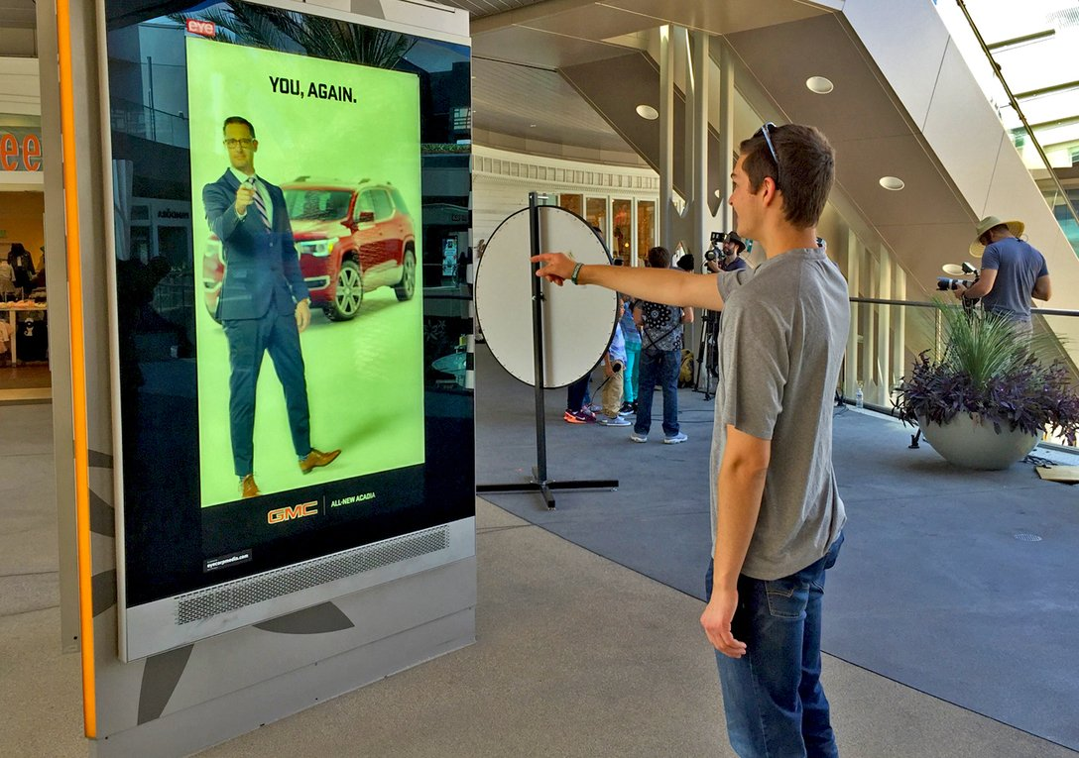

Innovations of DOOH: Facial Recognition
Locations: Santa Monica Place Shopping Mall
Company: GMC
Campaign: The New Acadia SUV, GMC Innovations: The camera in the digital display used artificial intelligence to detect audience demographics, such as age and gender, then serve one of 30 possible targeted video ads to the viewer. For example, if the anonymous audience detection facial analytics technology detected recognized a family with kids, the ad showed a video targeted at families. Passersby went out of their way to interact with the digital signage, and as people interacted more with the kiosk, it engaged them with interactive games like Simon Says.
https://www.verticalimpression.com/post/7-of-the-most-impressive-examples-of-digital-out-of-home-advertising-campaigns

Slide 10
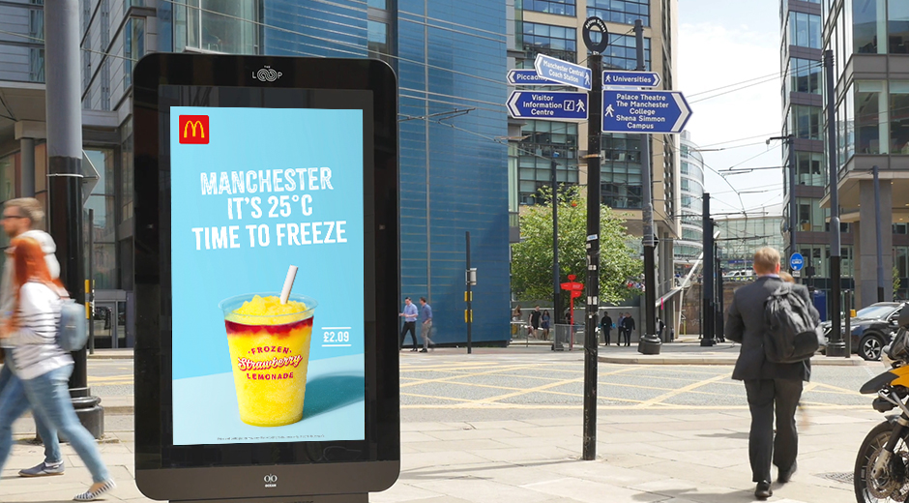
Innovations of DOOH: Weather Reactive
Locations: United Kingdom (UK)
Company: McDonalds
Campaign: McDonald's frozen drinks, strawberry lemonade and the "Millionaire's Frappe.”
Innovations: The campaign used weather data to advertise seasonal drinks. When the temperature rose above 22 degrees Celsius -- i.e. a temperature that was likely to make a cold drink more tempting to passersby -- the relevant campaign creative played on the digital signage. If the temperature hit above 25 degrees Celsius, the creative automatically updated to include the city name and current temperature. As the temperature dropped at night, the city name and current temperature were removed from the creative. This weather-reactive creative advertised McDonald's summer drinks in a much more engaging way than your typical static billboard, providing relevant, timely and useful content to audiences based on their ever-evolving lived experiences.
https://www.verticalimpression.com/post/7-of-the-most-impressive-examples-of-digital-out-of-home-advertising-campaigns

Slide 11
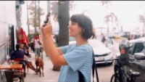
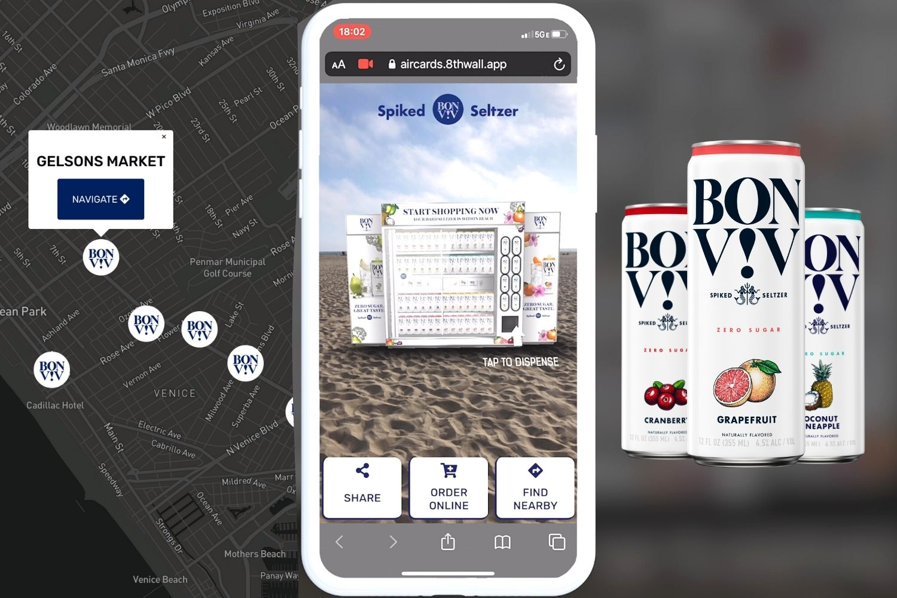
Innovations of DOOH: Augmented Reality
Locations: Los Angeles, San Diago
Company: BON V!V Spiked Seltzer
Campaign: 3D BON V!V vending machine
Innovations: Passersby could scan the QR code on the OOH printed mural to activate the experience. Once activated users could tap-to-place a fully functioning, virtual 3D BON V!V vending machine right in front of them using Web-based Augmented Reality! After placing the vending machine, they could browse the different flavors, choose their favorite and watch it get dispensed in a full (and very cool) 3D animation. BON V!V also gave consumers the ability to either use a custom maps functionality to navigate to the nearest store or a link to purchase online. This fully integrated AR Out-of-Home advertising campaign not only engaged customers and increased brand awareness, but also drove direct sales of the product.
https://www.aircards.co/blog/web-ar-out-of-home-campaign-with-ab-inbev-and-bon-v-spiked-seltzer

Slide 12
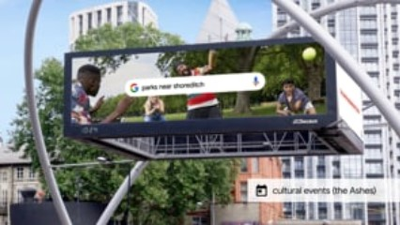
Innovations of DOOH: Search & Location-Specific
Locations: London, Manchester, and Birmingham
Company: Google
Campaign: Make the Most of Summer
Innovations: Full motion sites across London, Manchester, and Birmingham, list the results for search terms, including star ratings, opening times, and map directions with creative also reacting to time of day and local weather conditions, to provide the most relevant creative in the moment. At Old Street EC1, Google’s long-term digital holding in London, creative features additional location-specific, weather, time, day, and temperature triggers, and also taps into cultural events such as The Ashes, to contextualize creative during the campaign.
https://www.verticalimpression.com/post/7-of-the-most-impressive-examples-of-digital-out-of-home-advertising-campaigns
https://www.verticalimpression.com/post/7-of-the-most-impressive-examples-of-digital-out-of-home-advertising-campaigns

Slide 13
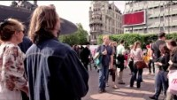
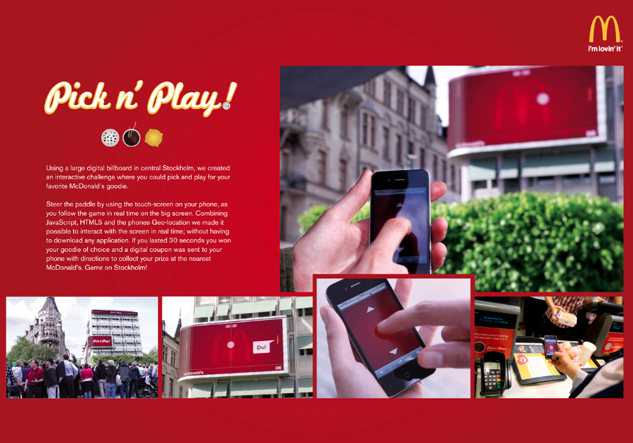
Innovations of DOOH: Gamification
Locations: Stockholm, Sweden
Company: McDonalds
Campaign: McDonalds Pick N Play Billboard Game
Innovations: The game didn’t require an app download or any other complicated procedure. All people had to do was go to the website that the billboard advertised, and it used their location data to make sure they were actually there. Consumers got to play, and they had to survive for 30 seconds. If they did, they were rewarded with a coupon for free food at one of the nearby restaurants.
https://www.verticalimpression.com/post/7-of-the-most-impressive-examples-of-digital-out-of-home-advertising-campaigns

Slide 14
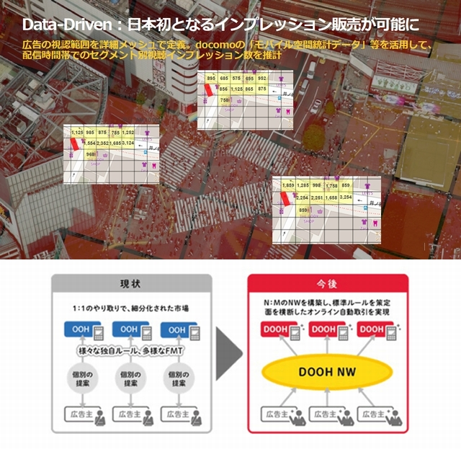
Liveboard
Divide the area with detailed mesh. Utilizing mobile spatial statistical data to calculate impressions at different times of day.
A fragmented market with 1:1 exchanges. Various unique rules by individual ad owners.
Create an AD network with standard rules and all online transactions.
https://digital-signage.jp/express/19571/

Slide 15
Thank you!
Sturfee Inc.
1551 McCarthy Blvd #206
Milpitas, California 95035
www.sturfee.com | medium.com/sturfee | @sturfee

